Slide 1
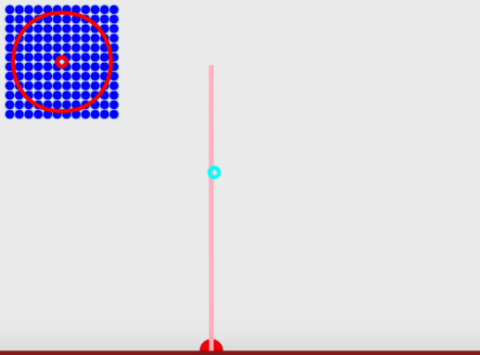
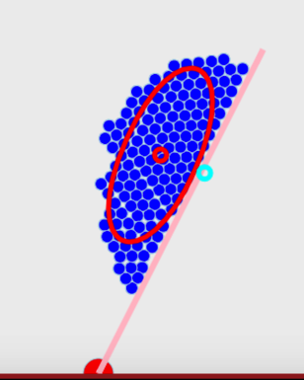
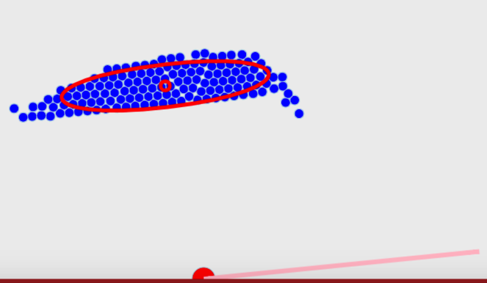
t = 0
t = 15
t = 30
Robots
Mean Position
Goal Position
Block
Pivot
C

